Slide 1
Flipping the Classroom for the First Time
Nataria Joseph
TechLearn Flipped Classroom Event
Fall 2018

Slide 2
AGENDA
Define Flipping the Classroom
Explain Decision-Making Process for Flipping
Demonstrate Examples & Related Tools: Sakai (Courses), Kahoot, Snagit
Outline Best Practices, Mistakes, Impacts

Slide 3
What is Flipping the Classroom?
Individual space
Structured (guided) individual learning before coming to the classroom
Can include videos, readings with intermittent questions, low stakes assessment, an action item for the group space
Group space
The traditional classroom time
Engage students in deepening, sharing, applying, unpacking their individual learning

Slide 4
How did I decide which class sessions to flip?
Those with most complex concepts
Those most difficult to get students engaged in with traditional lecture/discussion
Those concepts that need to be applied/practiced

Slide 5
Examples of What I Did
Psyc 310: Research Methods

Slide 6
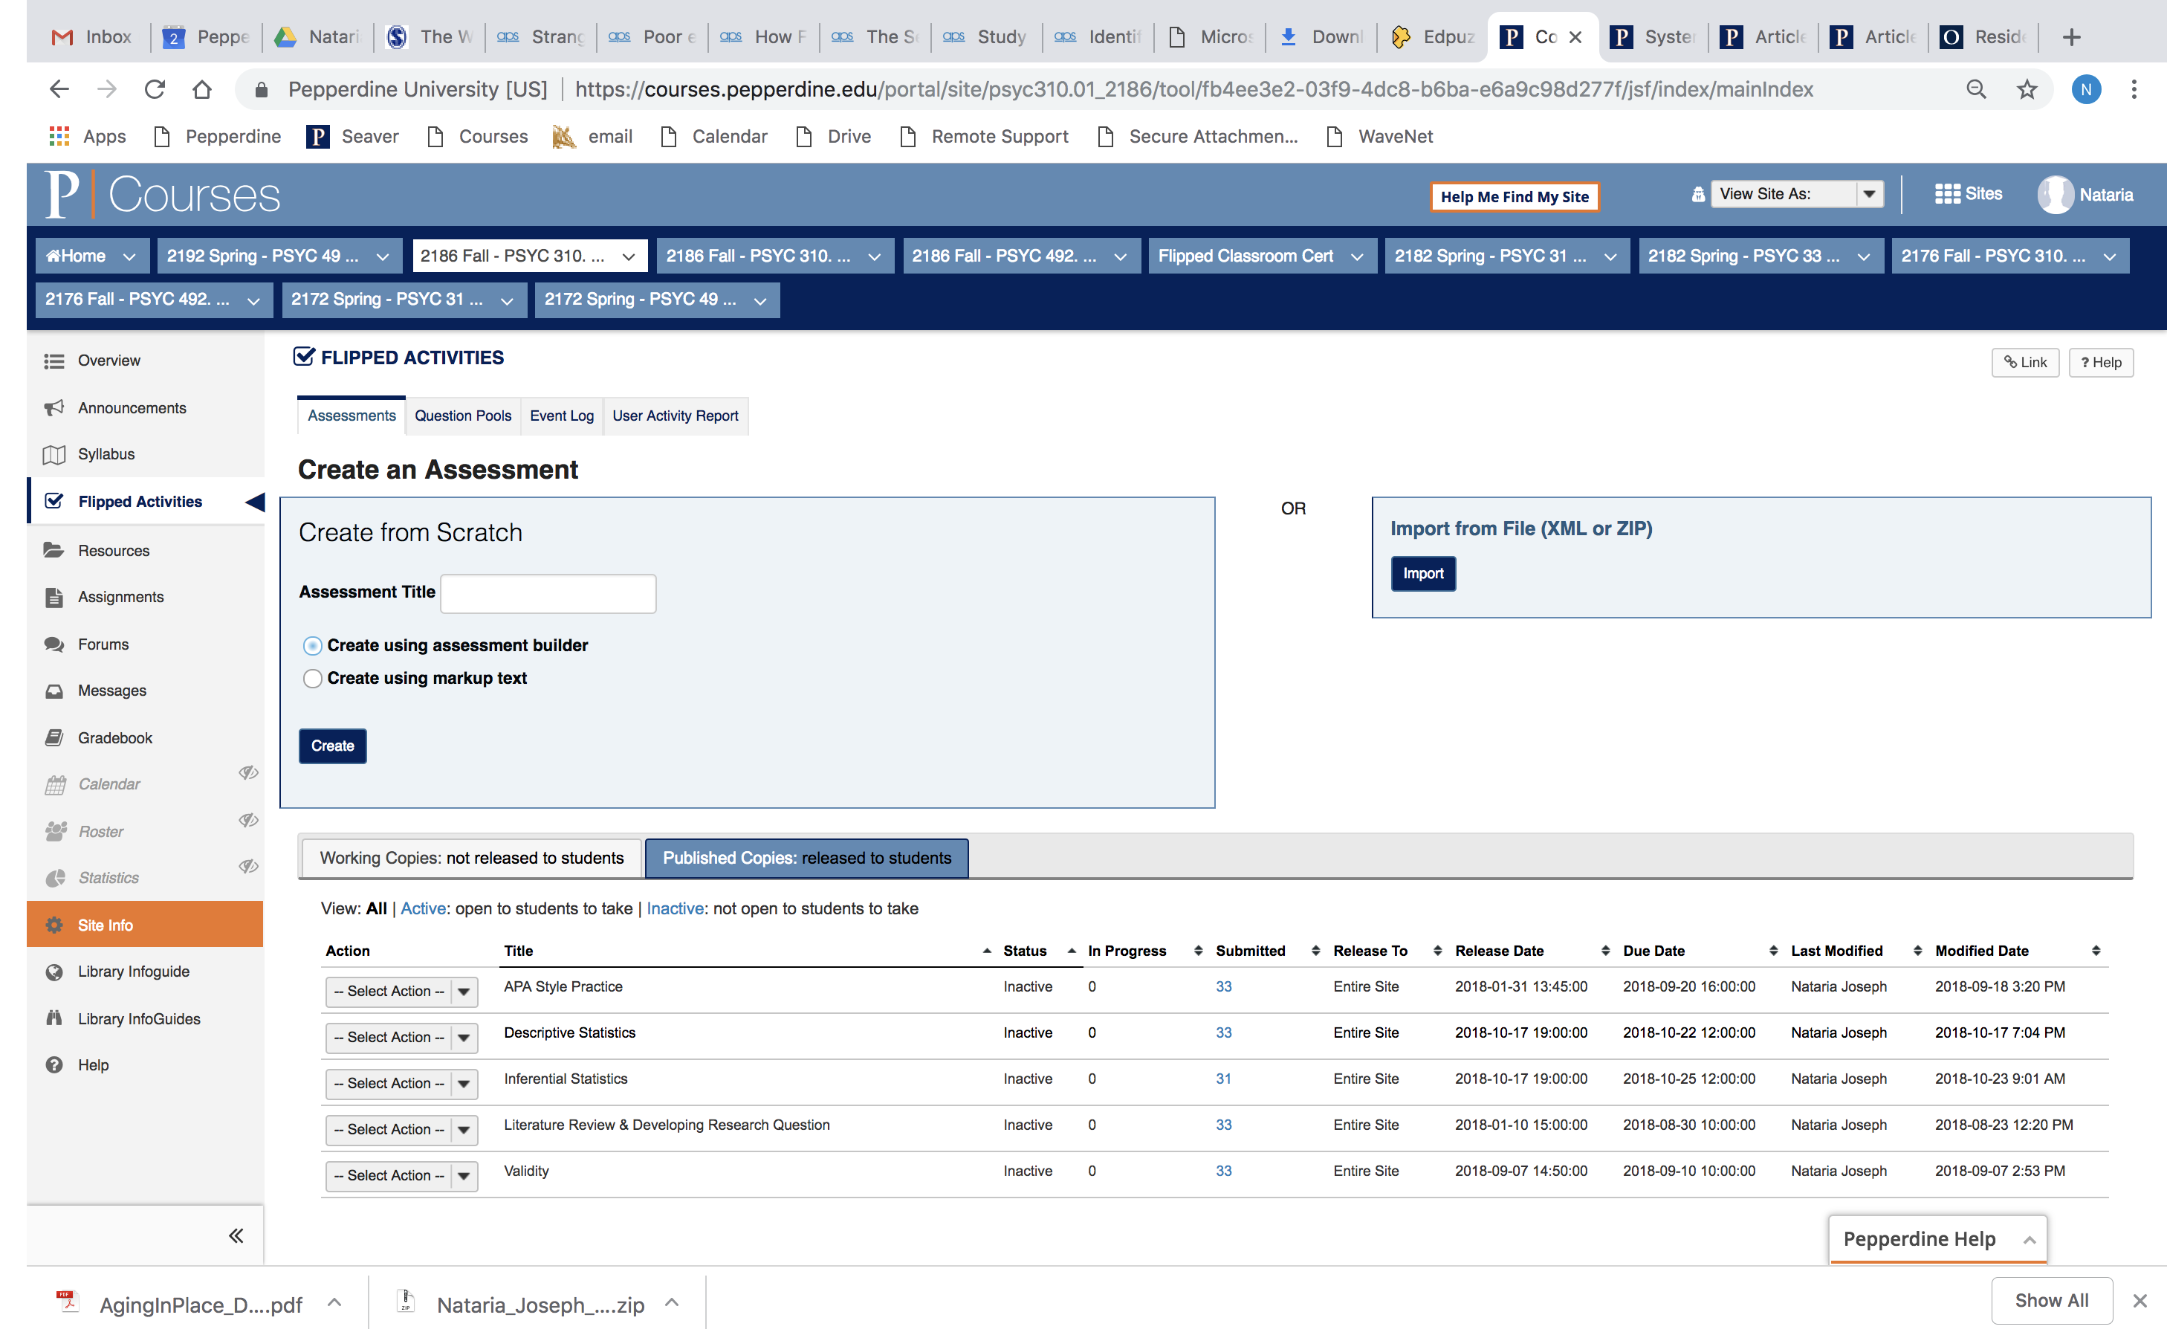
Tool for Housing Flipped Activities: Courses (Sakai)

Slide 7

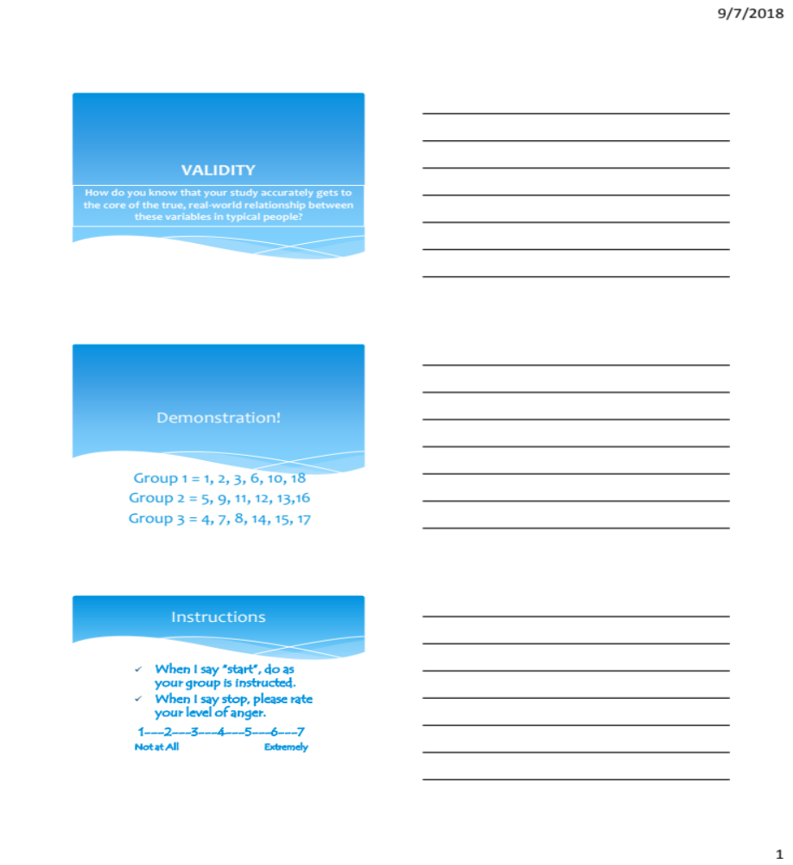
Validity Lesson Flipped
Individual space
Group space

Slide 8
Individual Space
(Tool Used: Snagit, Screen capture program)
DEMO
Samples: 0-:33 - Intro; 3:57-5:36 engaging them with working with the material; 15:18 – prepping them for the group space; low stakes assessment

Slide 9
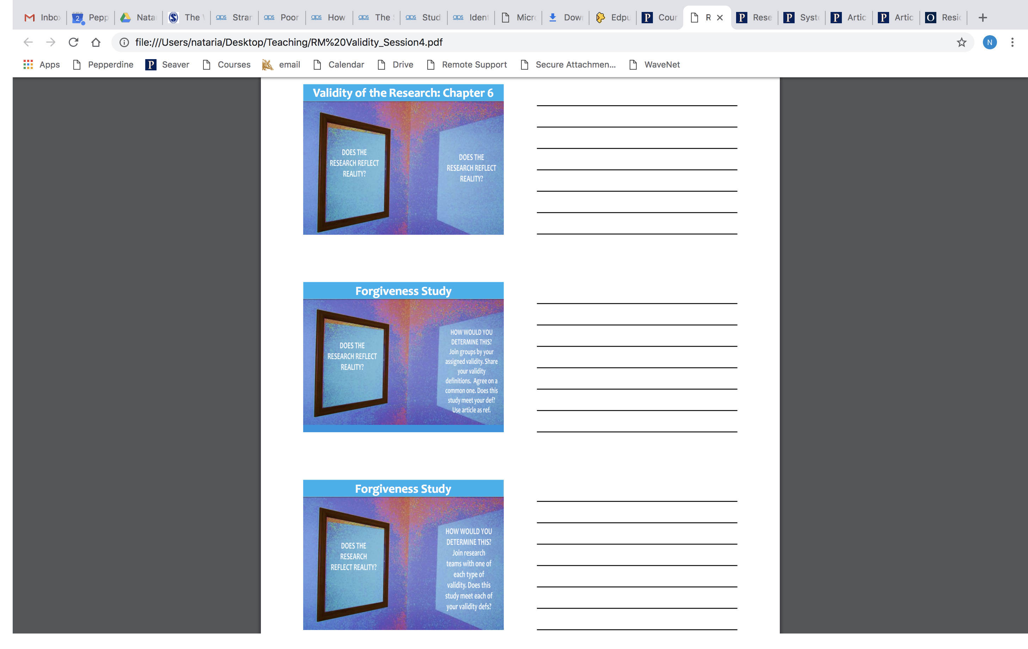
Group Space
(demos, Jigsaw technique, cooperative learning)

Slide 10
APA Style Flipped
Individual space
Make APA Style Reference Page from PDFs of articles from Pepperdine psychology faculty
Correct APA style errors in previous paper
Learn a specific APA Style rule (e.g., in-text citations (pages 174-179) - Jordan)
Group space
Tool Used: Kahoot (game-based); Jigsaw/cooperative learning
https://play.kahoot.it/#/k/96d1951b-2a59-4667-9a3c-2adb83c1e9cd
https://play.kahoot.it/#/k/3163c6fe-f64a-4893-9148-44649d86a79a

Slide 11
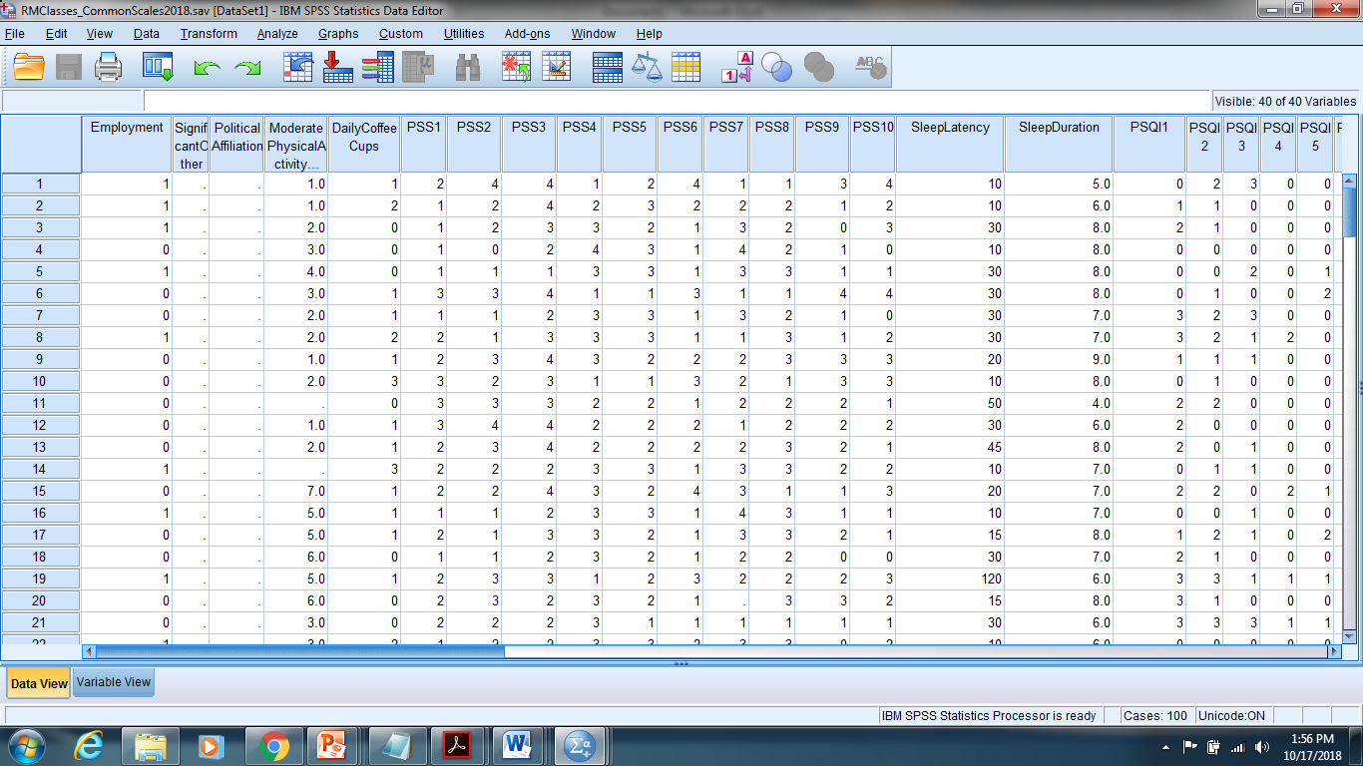
Statistics Flipped
Individual Space:
Learn concept & Practice SPSS
Each student assigned one concept and given instructions for executing on SPSS

Slide 12
Statistics Flipped
GROUP Space:
In Groups, Come up with common definition; Then demonstrate to rest of classmates on SPSS

Slide 13
Key Points
Best Practices
Videos should be 6 minutes or less
  Visual/audio of professor most effective
Structure individual space time - ask questions/low stakes assessments, have them interact with the material, e.g., write this in your own words
Group space – low stakes elaboration, apply to new examples, teach it to classmates

Slide 14
Key Points
Impacts on classroom
Student completion: nearly perfect
Student insight: were easily able to explain to me why I was having them do this
Student engagement: increased; Kahoot as anxiety provoking
Student learning / performance: Exam 1/2 scores 3 points higher than usual
I enjoy more!

